Slide 1
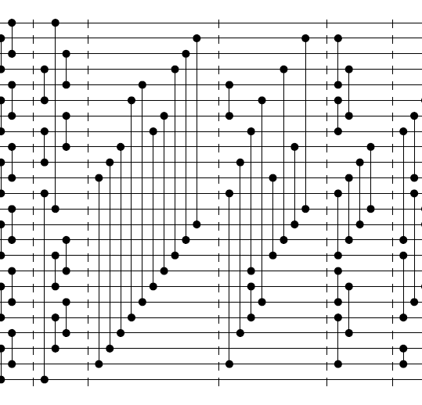
Merging almost sorted sequences yields a 24 sorter

Slide 2

Thorsten Ehlers
University of Kiel, Germany

Slide 3
TABLE OF CONTENT
Your Subtitle Here
1
Oblivious and non- oblivious algorithms
4
MISSION
Refers to a good or service being offered by a company ideally a product
Refers to a good or service being offered by a company ideally a product
2
WELCOME MESSAGE
5
VISION
Refers to a good or service being offered by a company ideally a product
Refers to a good or service being offered by a company ideally a product
3
MEET THE CEO
6
SERVICES
Refers to a good or service being offered by a company ideally a product
Refers to a good or service being offered by a company ideally a product

Slide 4
What are sorting networks?
Algorithms for sorting numbers (or anything else that can be ordered)
Any given sorting network only works on a fixed size input.

Slide 5
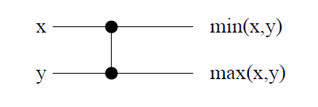
Comparator:

Slide 6
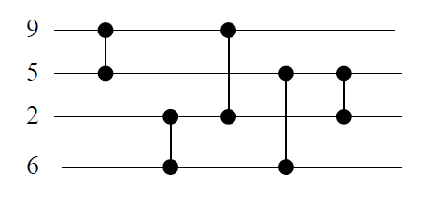
Example:
2
2
5
9
6
5
5
5
6
6
2
9
9
6

Slide 7
Sorting network is an oblivious sorting Algorithm:
Definition: an oblivious sort algorithm always makes the same comparisons, regardless of the input.

Slide 8
Oblivious sort algorithm is useful for external sorts, since there is a fixed I/O schedule, or parallel algorithms. Example for oblivious algorithm is Bitonic sort.

Slide 9
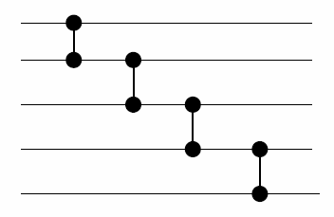
Running time of sorting network = depth which equals the time to produce all output values = number of layers

Slide 10
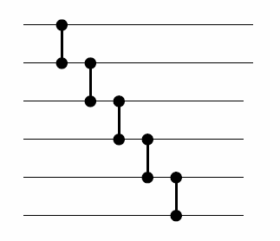
Size of network = number of comparators (5 in our example).

Slide 11
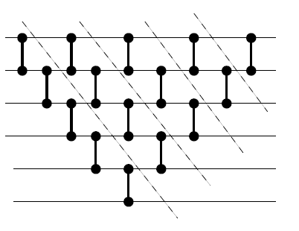

Selection Sort
This Block produces max of n inputs
Sort by recursively finding max, the max of the rest, and so on. Add one building block at a time:
What is the depth of the network?
An arithmetic sum from 1 to n, i.e. ($n^{2}$).

Slide 12
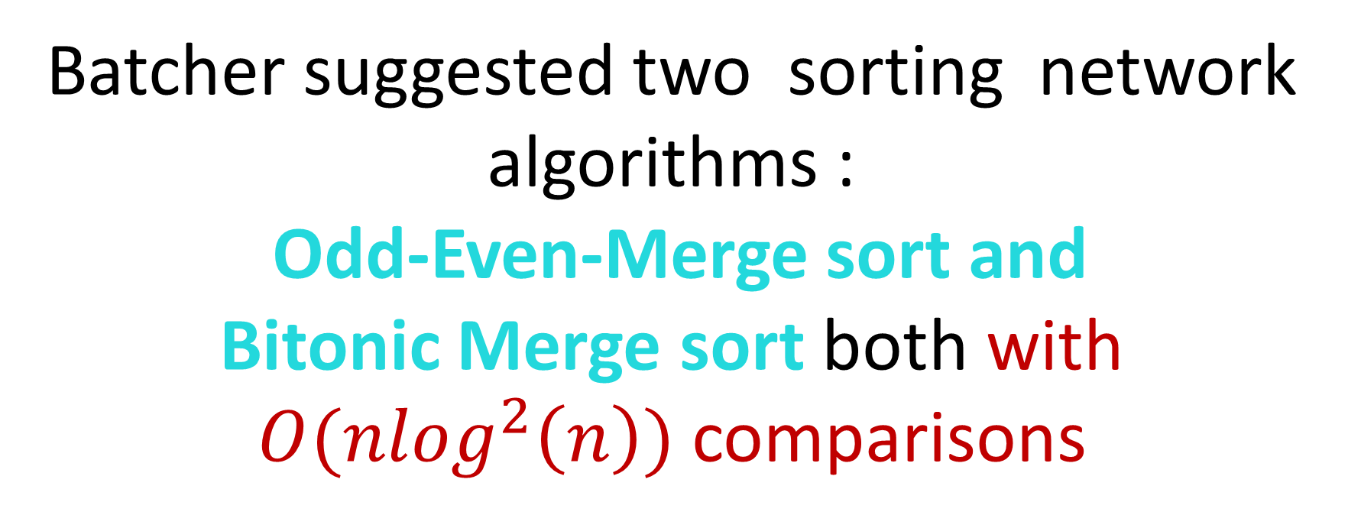
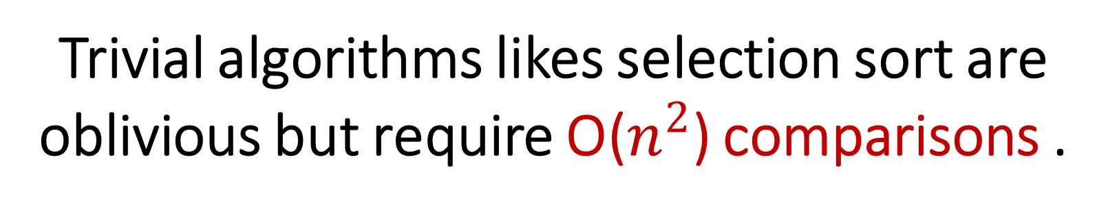
Trivial algorithms likes selection sort are oblivious but require O($n^{2}$) comparisons .
Batcher suggested two sorting network algorithms :
Odd-Even-Merge sort and
Bitonic Merge sort both with $O({nlog}^{2}\left(n\right))$ comparisons

Slide 13
Bitonic sequence is a sequence that either monotonically increases and the then monotonically decreases,
or monotonically decreases and then monotonically increases.
For example:
<1,4,6,8,3,2>
<9,8,3,2,4,6>
are both bitonic

Slide 14
A Bitonic sorter
A bitonic sorter is a network that sorts every bitonic sequence.
Algorithm:
1- A bitonic sequence is divided between its two halves.
2- The i^{th} element in each part is compared with each other. If they are out of order, they are swapped.
3- Applying this procedure repeatedly onto the smaller lists, the result is a sorted sequence in ascending order.

Slide 15


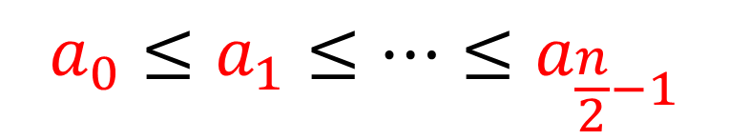
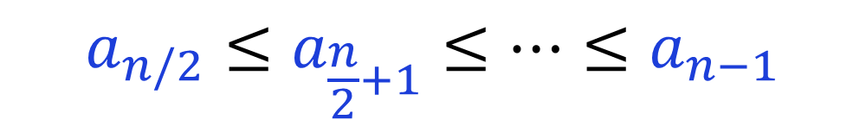
Let s = $<a_{0},a_{1},…,a_{n−1}>$ a bitonic sequence such that:
$$a_{0}≤a_{1}≤…≤a_{\frac{n}{2}−1}$$
and
$$a_{n/2}≤a_{\frac{n}{2}+1}≤…≤a_{n−1}$$

Slide 16
